Slide 1
Introduction to TensorFlow
Haosheng Zou
May 15, 2018
Slides credit: Jon Gauthier

Slide 2
Contents
Motivation and abstract model
NN feedforward
NN back-propagation

Slide 3
What is TensorFlow?
In short: TensorFlow is Theano++.
Symbolic ML dataflow framework that compiles to native / GPU code

Slide 4
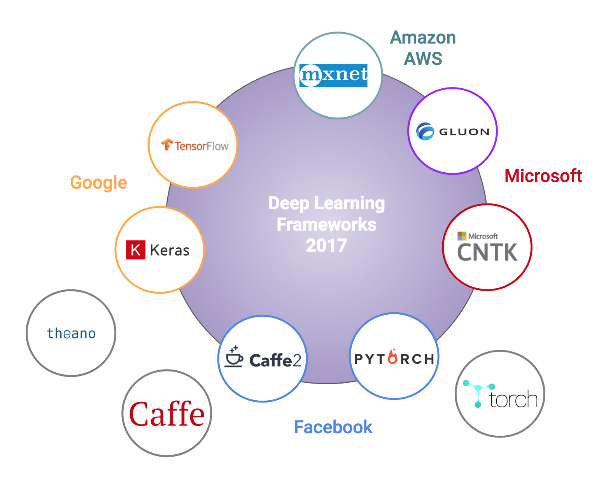
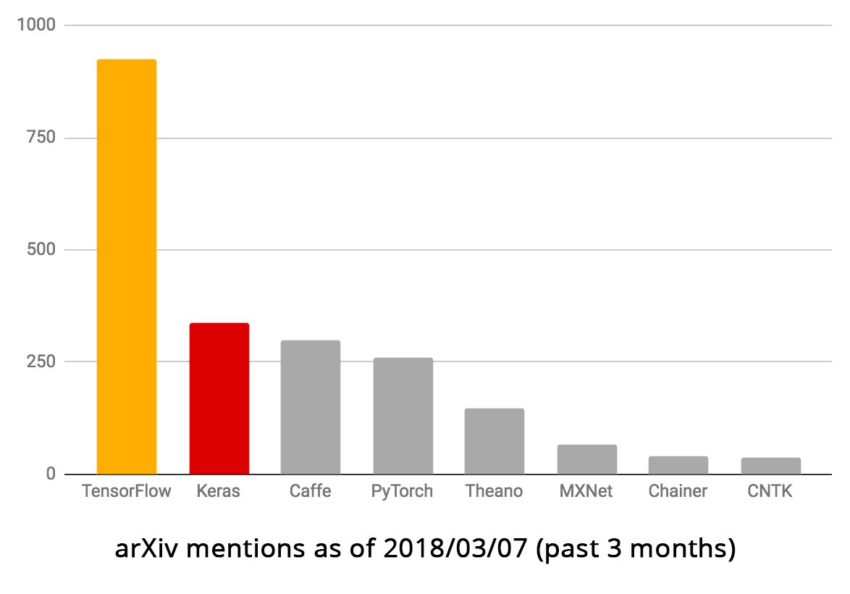
TensorFlow

Slide 5
Programming model
Big idea: Express a numeric computation as a graph.
Graph nodes are operations which have any number of inputs and outputs
Graph edges are tensors which flow between nodes
For the underlying Python classes, see for yourself.

Slide 6
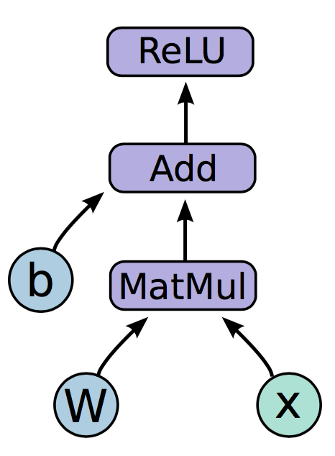

Programming model: NN feedforward

Slide 7
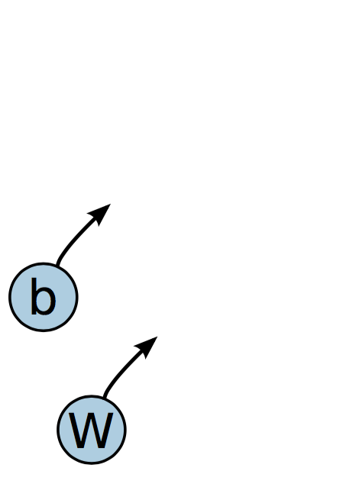
Programming model: NN feedforward
Variables are 0-ary stateful nodes which output their current value.
(State is retained across multiple executions of a graph.)
(parameters, gradient stores, eligibility traces, …)

Slide 8
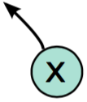
Programming model: NN feedforward
Placeholders are 0-ary nodes whose value is fed in at execution time.
(inputs, variable learning rates, …)

Slide 9
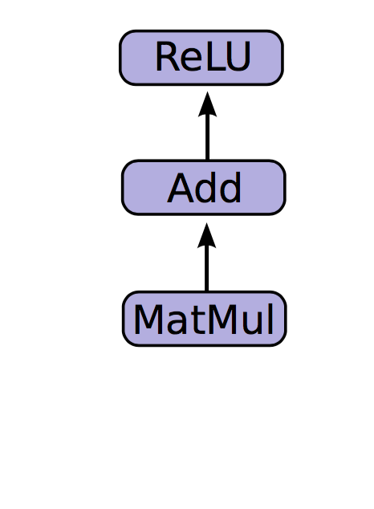
Programming model: NN feedforward
Mathematical operations:
MatMul: Multiply two matrix values.
Add: Add elementwise (with broadcasting).
ReLU: Activate with elementwise rectified linear function.

Slide 10
In code, please!
import tensorflow as tf b = tf.Variable(tf.zeros((100,))) W = tf.Variable(tf.random_uniform((784, 100), -1, 1)) x = tf.placeholder(tf.float32, (None, 784)) h_i = tf.nn.relu(tf.matmul(x, W) + b)
1
Create model weights, including initialization W ~ Uniform(-1, 1); b = 0
Create input placeholder x batch_size * 784 input matrix (None for variable length, e.g. batch_size, sequence length)
Create computation graph
2
3

Slide 11
How do we run it?
So far we have defined a graph.
We can deploy this graph with a session: a binding to a particular execution context (e.g. CPU, GPU)

Slide 12
Getting output
import numpy as np import tensorflow as tf b = tf.Variable(tf.zeros((100,)))
W = tf.Variable(tf.random_uniform((784, 100),
-1, 1))
x = tf.placeholder(tf.float32, (None, 784))
h_i = tf.nn.relu(tf.matmul(x, W) + b)
sess.run(fetches, feeds)
Fetches: almost anything you defined on the LHS, in almost any container (list, dict, single…)
Feeds: Dictionary mapping from graph nodes to concrete values. Specifies the value of each graph node given in the dictionary.
sess = tf.Session() sess.run(tf.global_variables_initializer()) sess.run(h_i, {x: np.random.random(64, 784)})

Slide 13
How do we train it?
So far we have only run feedforward to get output.
How to train tf.Variables with back-propagation?

Slide 14
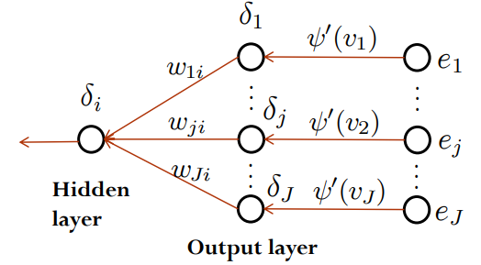
Programming model: Auto-Differentiation
Define error signal (loss) and let TensorFlow compute the gradients itself!
loss is also a tensor
tf.gradients(loss, variables)
tf.Optimizer.minimize(loss, variables)

Slide 15
Training
import numpy as np import tensorflow as tf x = tf.placeholder(tf.float32, (None, 784))
h = tf.layers.dense(x, 400, activation=tf.nn.relu)
logits = tf.layers.dense(h, 10, activation=None)
loss = tf.nn.softmax_cross_entropy_with_logits(labels=y,
logits=logits)
train_op = tf.train.AdamOptimizer.minimize(loss)
tf.layers implicitly creates the variables.
Cross entropy loss without building softmax tensor is more stable.
Optimizer defaults to optimize over all variables got by tf.GraphKeys. TRAINABLE_VARIABLES
sess = tf.Session() sess.run(tf.global_variables_initializer()) sess.run(train_op, feed_dict=)

Slide 16
Basic workflow
Build a graph
Graph contains parameter specifications, model architecture, optimization process, …
Build everything before initializing a session (otherwise maybe very slow!).
Eager execution not covered.
Initialize a session
Fetch and feed data with Session.run
Compilation, optimization, etc. happens at this step — you probably won’t notice

Slide 17
Questions? More tutorials: https://www.tensorflow.org/tutorials/layers https://www.tensorflow.org/programmers_guide/tensors https://www.tensorflow.org/programmers_guide/variables

Slide 18
TianShou: A Reinforcement Learning Library
Haosheng Zou &
Dong Yan, Tongzheng Ren, Wenbo Hu, Yong Ren, Shihong Song, Jialian Li
May 15, 2018

Slide 19
Current Status
https://github.com/thu-ml/tianshou
Preliminary tutorials & API docs @ http://ml.cs.tsinghua.edu.cn/~haosheng/tianshou/

Slide 20
Contents
TianShou
Other RL Libraries

Slide 21
The Name, TianShou
“天授”
天授之才
百度百科：
唐·刘禹锡《天论下》：“在舜之庭，元凯举焉，曰舜用之，不曰天授。”
唐·司马贞《史记索隐》：“按：赞飨之辞言天授。皇帝泰元神策，周而复始。”
鲁迅《中国小说史略》第二篇：“传说之所道，或为神性之人，或为古英雄，其奇才异能神勇为凡人所不及，而由于天授，或有天相者，简狄吞燕卵而生商，刘媪得交龙而孕季，皆其例也。”
北朝刘获和郑辩、武周武则天、大理段正淳、日本长庆天皇等的年号。
import tianshou as ts

Slide 22
TianShou’s Idea
Lower-level abstraction of the algorithms:
Objective (REINFORCE, PPO)
Gradient: DPG
Optimizer: TRPO
DRL → supervised DL
Loss
Data
SGD on mini-batches of data

Slide 23
TianShou’s Architecture
Applications
Classic Control
MuJoCo Control
Atari game-playing
Alpha-Zero
RL Fine-tuning
……
RL Algorithms
Deep Q-learning (DQN)
REINFORCE, A2C
TRPO
PPO
DDPG
……
Infrastructure
Network Wrapper
Memory
Reward Processor
Loss & Optimizer

Slide 24
Example: DDPG
“Continuous Control with Deep Reinforcement Learning” by DeepMind
DDPG Algorithm:
Train critic (Q value function) with mean squared error
Train actor with gradients from Q value function (as GAN)

Slide 25
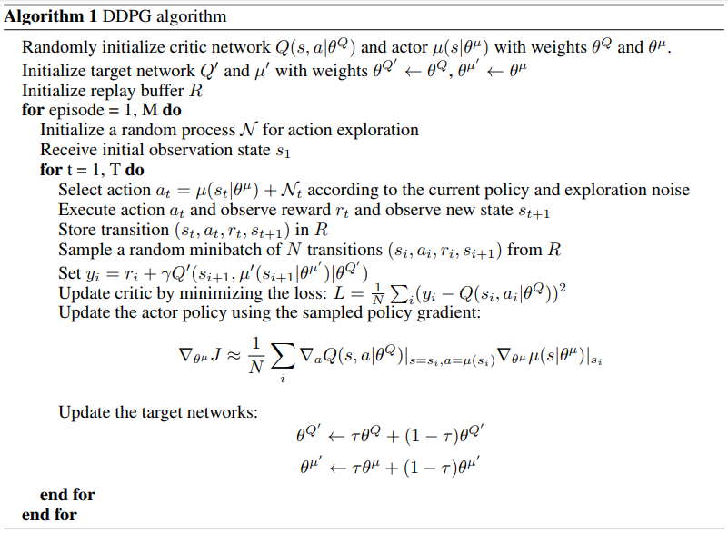
Example: DDPG

Slide 26
DDPG step-by-step: define task
In DL, read data (e.g., MNIST images, labels)
In RL, define environment
import tianshou as ts
env = gym.make('Pendulum-v0')

Slide 27
DDPG step-by-step: build network
In DL, build network starting from input
In RL, the same.
net = tf.layers.dense(observation_ph, 32,
activation=tf.nn.relu)
net = tf.layers.dense(net, 32,
activation=tf.nn.relu)
action = tf.layers.dense(net, action_dim[0],
activation=None)
action_value_input = tf.concat([observation_ph,
action_ph], axis=1)
net = tf.layers.dense(action_value_input, 64,
activation=tf.nn.relu)
net = tf.layers.dense(net, 64,
activation=tf.nn.relu)
action_value = tf.layers.dense(net, 1,
activation=None)

Slide 28
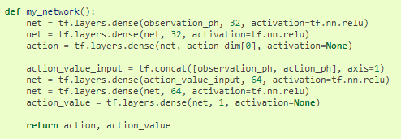
DDPG step-by-step: build network
In TianShou, a further restriction:
All parts of the TensorFlow graph construction, except placeholder instantiation, have to be wrapped in a single parameter-less Python function by you.
The function must return a doublet, (policy head, value head), with the unnecessary head (if any) set to ``None``.

Slide 29
DDPG step-by-step: build network
Wrap the network into policy/value function
actor = ts.policy.Deterministic(my_network,
observation_placeholder=observation_ph,
has_old_net=True)
critic = ts.value_function.ActionValue(my_network,
observation_placeholder=observation_ph,
action_placeholder=action_ph,
has_old_net=True)

Slide 30
DDPG step-by-step: build optimization
In DL, define loss, optimizers…
In RL with TianShou, almost the same
critic_loss = losses.value_mse(critic)
critic_optimizer = tf.train.AdamOptimizer(1e-3)
critic_train_op =
critic_optimizer.minimize(critic_loss,
var_list=list(critic.trainable_variables))
dpg_grads_vars = opt.DPG(actor, critic)
actor_optimizer = tf.train.AdamOptimizer(1e-3)
actor_train_op =
actor_optimizer.apply_gradients(dpg_grads_vars)

Slide 31
DDPG step-by-step: Data
In DL, you only have to sample minibatches of data.
In RL, data are acquired and utilized in a more complex way.
With TianShou, things are not so complex.
data_buffer =
VanillaReplayBuffer(capacity=10000, nstep=1)
process_functions =
[advantage_estimation.ddpg_return(actor, critic)]
data_collector = DataCollector(
env=env,
policy=actor,
data_buffer=data_buffer,
process_functions=process_functions,
managed_networks=[actor, critic]
)

Slide 32
DDPG step-by-step: run!
In DL, initialize a session and start running.
In RL with TianShou, things are almost the same.
Check the ddpg.py under examples/

Slide 33
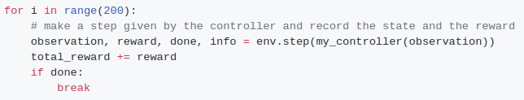
Other RL Libraries
Environment
Policy (network architecture)
Algorithm (to train policy)
Environment:
OpenAI Gym, DeepMind Control Suite…
Policy: deep learning library
TensorFlow, Keras…

Slide 34
Algorithm Libraries
Keras-RL
OpenAI Baselines
RLLab
TensorForce
Intel/Coach

Slide 35
Algorithm Libraries
Keras-RL
OpenAI Baselines
RLLab
TensorForce
Intel/Coach

Slide 36
Keras-RL
Algorithms:
Various DQNs
DDPG, NAF
Not many, no parallel
Network written in Keras
Code example

Slide 37
Algorithm Libraries
Keras-RL
OpenAI Baselines
RLLab
TensorForce
Intel/Coach

Slide 38
OpenAI Baselines
Algorithms:
Various DQNs
DDPG, NAF, TRPO, PPO, A2C, ACKTR
Many, parallel
Based On TensorFlow
Webpage
Results are great
Algo-by-algo, has to go to source code for adaptations

Slide 39
Algorithm Libraries
Keras-RL
OpenAI Baselines
RLLab
TensorForce
Intel/Coach

Slide 40
RLLab
Algorithms:
REINFORCE, TRPO, DDPG
Derivative-free evolutionary
Only continuous action space, no parallel
Based on Theano
sandbox/tf with fewer algos
No recent updates

Slide 41
Algorithm Libraries
Keras-RL
OpenAI Baselines
RLLab
TensorForce
Intel/Coach

Slide 42
TensorForce
Algorithms:
Almost as many as OpenAI Baselines
Parallel
Based on TensorFlow
Using with config
Webpage
(should be) easy to use

Slide 43
Algorithm Libraries
Keras-RL
OpenAI Baselines
RLLab
TensorForce
Intel/Coach

Slide 44
Coach
Algorithms:
The most
Parallel
Based on TensorFlow or Neon
Usage like OpenAI Baselines
Webpage

Slide 45
Questions?

